Slide 1
Computing Models Overview

Slide 2
Agenda
What is the computing model?
Batch processing
Remote Job Entry and autonomous agents
Host & terminal
Desktop PC
Need for sharing
File server & workstation
Client & server
Three-layer C/S model
Cloud solution

Slide 3
What is the computing model?
A complex picture of:
Application storage
Data origin, data input
Application balancing
Data processing and storage
User roles and actions
Describes:
Time relations
Physical relations
Ownership

Slide 4
Computing models
Depend on:
Hardware and software capabilities
Networks availability and connection
User and manufacturer preferences
Pressures to minimize costs
Security needs
The computing model is under constant development

Slide 5
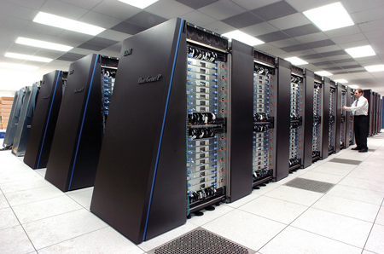
Batch processing
Computer processing of information that has been assembled into batches of transactions prior to input
The batch in on the punched card (history) or other media
Input
Output printing
Mainframe or supercomputer
Today: complex computing tasks solved on supercomputers
Picture: purposeof.com.au
Notes:
Eg. Printing – works even today

Slide 6
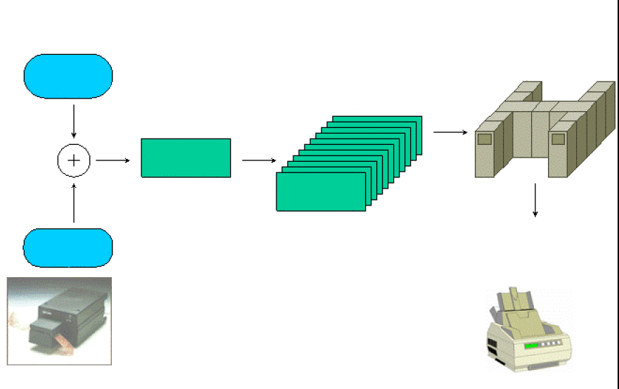

Batch Processing
queue of batches (tasks)
processing
program
batch
batch
data
output
report
Rules for assembling data and instructions –
Job Control Language
Source: J.Peterka. www.earchiv.cz, Punched card picture: en.wikipedia.org

Slide 7
Batch processing
Pros | Cons
Efficient use of hardware | Lack of interactivity
Pressure on user / operator to prepare a bug less batch | Need for advanced user skills

Slide 8
Remote Job Entry & agents
Remote Job Entry (RJE)
Newer form of batch processing
The batch prepared on workstation and send to the server (supercomputer)
Autonomous agents
Software module with data (batch) that conducts the data processing autonomously
E.g. web crawlers and bots

Slide 9
Decomposition of a complex task
2*(23-7)+((14/2)+(8+12)*(9-8))-(8*9)+((7*2)*(6-2))-(((2*3)+(4-7))-(9-7))=?
The task is too time-difficult and space-consuming for one computational power.
De-composition allows us to solve it using several smaller/slower machines.

Slide 10



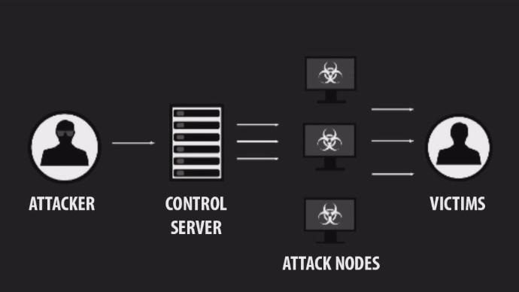
Gathering of the computational power
Voluntary
BOINC
Payed
Cryptocurrency
Stolen
Botnets

Slide 11
Interactive processing
Mainframe < - > terminals/workstations
Each user action causes a response
Exchange of information between a user and a computer
Work in real time

Slide 12
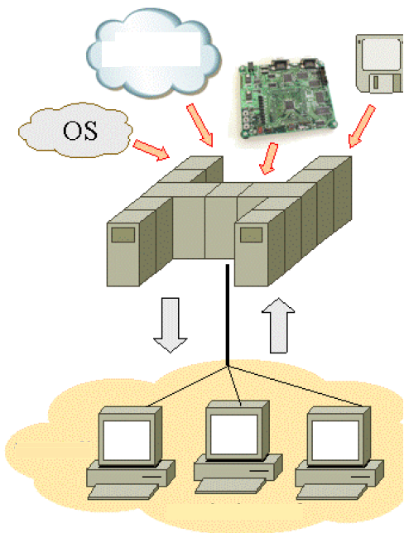
Host / Terminal
data
CPU
application
host
computer
display
output
keyboard input
terminals
Source: J.Peterka. www.earchiv.cz.
Notes:
Host computer = holds resources (CPU, memory, database), processes user’s requests, sends data
Terminal computer = only sends user’s inputs and receives host’s outputs

Slide 13
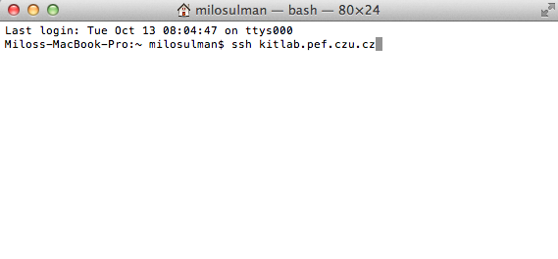
Host / Terminal - example

Slide 14
Host / Terminal
Terminal is an application running on hosting computer
In practice: remote desktop management (LANDesk, ZENworks, etc.)
Pros | Cons
Fast connection | No or limited graphic interface
Only text is transmitted | Need for command line skills
Easier maintenance

Slide 15
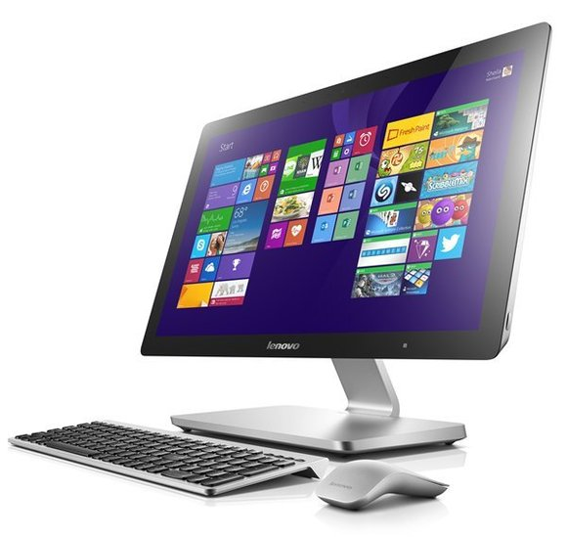
Desktop PC
Since 1980s
Connected with hardware advancements and price decrease
Major platform: Windows, alternative: Mac
Change: data processing at the user
Pictures: purposeof.com.au, pcworld.com

Slide 16
Desktop PC
A computer intended for stand-alone use by an individual
Higher productivity of work
Inexpensive price
Mass production
Exponential increase in the power of PC
Every 2-3 years new hardware and software

Slide 17
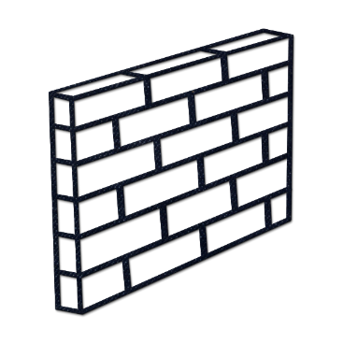
Desktop PC
Host / terminal
Desktop PC
Shift to “decentralization”
Multiplication of management ( x stations = Nx issues)
Icons: iconsets.com

Slide 18
Seek for compromise
Sharing vs. owning
Sharing | Owning
Storage | Basic input and output devices
Printer | CPU
Network | Memory

Slide 19
Need for sharing – inception of LANs
LAN = Local Area Networks
Fast network connection (100 Mbit/s or more)
Seamless sharing of application and data
E.g. virtual desktops in FEM computer rooms

Slide 20
LAN
Computer network of PC
One or more servers
Different topologies/configurations:
bus, star, ring
Speed of transmission 10 Mbps -1Gbps
Transmission medium - coaxial cable, twisted pair, optical fibres

Slide 21




File server / work station
Server provides files and folders as network drives
Seamless mapping of network drives on work stations
E.g. Novell client at CULS
LAN
Icons: iconsets.com

Slide 22
File server / work station
Pros | Cons
Data and application sharing | Configuration for multiple users
No network capability needed (e.g. Microsoft Office) | Multiple access to single file
 | Large volume transfers

Slide 23
Client / Server
server
client
request
respond
Icons: iconsets.com

Slide 24
Client / Server Architecture
More general concept - middleware
clients - PC
servers - database, print, file
Distribution of tasks in
Presentation
Computing (application logic)
Storage (data)

Slide 25

Styles of Client / Server computing
Distributed
Presentation
Remote
Presentation
Distributed
Logic
Remote Data
Management
Distributed
Database
Data Management
Data Management
Data Management
Data Management
Data Management
Application
Logic
Application
Logic
Application
Logic
Presentation
Data
Management
Application
Logic
Application
Logic
Application
Logic
Presentation
Presentation
Presentation
Presentation
Presentation
Icons: iconsets.com

Slide 26
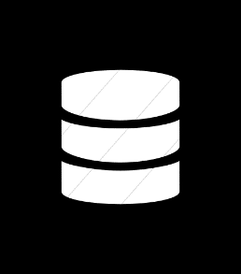

Client / server vs. Peer-to-peer
LAN
LAN
Icons: iconsets.com

Slide 27
Three-layer C/S model
In traditional C/S model – for each client platform … new client application.
Updates, compatibility issues.
Cost of the life cycle.
Reduce the supported platforms list?
Or to use general application as „universal client“?
Which application can be used for this?

Slide 28
Possible solutions
A virtual environment which is platform-independent
Java (JRE)
Existing platform-dependent application with a general standardized interface
WWW client with HTML 5 (aka „web browser“)
Server
providing apps
Universal client running in the host OS
User application in UC

Slide 29
Cloud solution
The provider of a service (application, storage, processing) is physically independent on the user location.
User is provided just with the entry-point for the services.
Both parties are connected by some universal network – the Internet.
Also in-house solution.
Examples: Office365, Google Apps, iCloud…

